Slide 1
International Economics
4. International Financial Market Crises
Notes:
Hello everybody! This is lesson 22 of the lecture “International Economic Relations”. I will discuss slides 1 to 20 of Chapter 4 “International Financial Market Crises”.

Slide 2
4. International Financial Market Crises
4. International Financial Market Crises
4.1. The Ingredients of a Financial Market Crisis
4.2. Lessons from History
4.2.1. The Dutch Tulip Crisis 1636-37
4.2.2. The World Economic Crisis of 1929
4.2.3. The Dot-com Crisis 2000
4.2.4. The Subprime Crisis 2007-09
4.2.5. The East Asian Financial Market Crisis 1997-98
4.2.6. The European Debt Crisis 2010
Literatur:
◆ Kindleberger Charles, Robert Aliber, (2005), Manias, Panics and Crashes, A History of Financial Market Crisis, 5th Edition, John Wiley & Sons, New Jersey.
◆ Minsky, Hyman, 1991, The Financial Instability Hypothesis, Bard College Working Paper, http://papers.ssrn.com/sol3/papers.cfm?abstract_id=161024.
◆ Minsky, Hyman, 1992, Financial Crisis: Systemic or Idiosyncratic, Bard College Working Paper, http://papers.ssrn.com/sol3/papers.cfm?abstract_id=161024.
◆ Meltzer, A., (1998), Asian Problems and the IMF, The Cato Journal 17, S.267-274.
◆ Rogoff, K. and Carmen Meinhardt, (2008), This Time is Different: A Panoramic View of Eight Centuries of Financial Crisis. Havard University Working Paper, www.economics.harvard.edu/faculty/rogoff/files/This_Time_Is_Different.pdf .
Notes:
2
As we have seen, the openness of countries to international trade and capital movements can bring a number of advantages.
In has however also repeatedly resulted in financial market crises, which easily spread across many countries, often causing crises in the real economy too.
This chapter deals with historical financial market crises episodes. Above all, the similarities in the formation and course of these crises are examined.

Slide 3
4. International Financial Market Crises
4. International Financial Market Crises
4.1. The Ingredients of a Financial Market Crisis
Notes:
2
First, we will however discuss theoretical approaches to explain, why financial market crises can occur. The formation of speculative bubbles plays an important role here.

Slide 4
4.1. The Ingredients of a Financial Market Crisis
Nearly all episodes of historical financial market crises followed a quite similar pattern.
  It starts with a price increase over a longer period for a particular good or asset.
  The price rise begins relatively slowly and then leads to increasingly stronger and ultimately exponential growth.
  Finally, the price rise abruptly ceases and a steep price decline occurs in a relatively short time.
  A recovery will then start only in the long-run.
This observable pattern is explained quite well by the "theory of speculative bubbles".
According to this theory, the emergence of financial market crises is always probable when the following conditions are met:
Notes:
2
FTXT

Slide 5


4.1. The Ingredients of a Financial Market Crisis
The basic ingredients of a financial market crisis:
  An Initial Shock
  A Positive Feedback Mechanism
  A Funding Source
  A Negative Shock
The first three ingredients create a speculative bubble.
The last ingredient is the needle, which bursts the bubble.
Notes:
2

Slide 6
4.1. The Ingredients of a Financial Market Crisis
A Initial Shock
  Most historically observed financial market crisis were started by a unpredictable event – a shock.
  As we will see such shocks can be:
    Technological Innovations:
      New products, services, production technologies, raw materials…
    Financial Market Innovations
      New assets, derivatives, investment strategies…
    Financial Market Deregulation
      Less restrictions concerning prices, own capital, scope of markets, cooperation,…
    Political Events
      Change of governments, end of wars…
Notes:
2
FTXT
electrification [elec.] die Elektrifizierung

Slide 7
4.1. The Ingredients of a Financial Market Crisis
A Positive Feedback Mechanism
  Most important ingredient:
    An event reproduces the conditions of its own creation.
  Markets for assets have a susceptibility for such feedback mechanisms if people rely on naïve expectations.
  Naïve expectations are given, if people believe that the currently observable increase of prices will hold on in the future:
    “Next months increase of stock prices, will be equal to the current increase of stock prices.”
Notes:
2
FTXT

Slide 8
4.1. The Ingredients of a Financial Market Crisis
A Positive Feedback Mechanism:
Purchases of the asset in order to profit from the price increase
Demand of the asset grows stronger than supply
Expectations of an asset price increase
Contradiction to standard neoclassical theories!
Naïve expectations
Asset price increases
Notes:
2
One can describe a positive feedback effect with the help of a circular graph.
Let us assume that due to an initial shock, such as a technological innovation, a large group of market participants form the expectation that the price of a stock company will rise.
…if new information arrives that a certain stock company will make more profits, people expect a price increase of the stock of this company.

Slide 9
4.1. The Ingredients of a Financial Market Crisis
P
Period: t
X_{S}
Excess _Supply
Initial situation: The expected price is the same as the current price: : E_{t}(P_{t+1}) = P¹_{t}
=> No speculative demand
P_{t}
Example for a negative Feedback Mechanism
P¹_{t}
P_{t}
Excess Demand
X_{D}(P_{t}, E_{t}(P_{t+1}) = P¹_{t})
X
X¹_{t}
Prof. Dr. Rainer Maurer
Notes:
One can also show the emergence of a positive feedback effect with the help of a market diagram.
Markets are usually negative feedback mechanisms. This means that market equilibria are usually stable.
If a price exceeds the market equilibrium price due to random fluctuations, CLICK this creates an excess supply, which then leads to falling prices again.
If a price falls below the market equilibrium price due to random fluctuations, CLICK this creates excess demand, which then leads to the price rising again.
This means that deviations from the market equilibrium are corrected again and again by market forces. The market equilibrium is therefore stable. Speculative bubbles cannot develop under these conditions.

Slide 10
4.1. The Ingredients of a Financial Market Crisis
P
Change: New information (=initial shock) leads to a higher expected price of the next period: E_{t}(P_{t+1}) > P¹_{t}
=> Additional purchases by speculators
Period: t
X_{S}
P²_{t}
P¹_{t}
X_{D}(P_{t}, E_{t}(P_{t+1}) > P¹_{t})
X_{D}(P_{t}, E_{t}(P_{t+1}) = P¹_{t})
X
X¹_{t}
X²_{t}
Prof. Dr. Rainer Maurer
Notes:
It is different, however, when it comes to storable goods and market participants form naive price expectations.
Let’s start assuming that new information, for example reports that a company has received a patent for an innovation, is expected to increase the price of the shares, so that the demand for the company's shares increases.

Slide 11
4.1. The Ingredients of a Financial Market Crisis
P
Now naïve expectations lead to a higher expected price of the next period
E_{t+1}(P_{t+2})= P¹_{t+1}*(P¹_{t+1}-P¹_{t})/P¹_{t} > P¹_{t+1}
=> Further purchases by speculators
Period: t+1
X_{S}
P²_{t+1}
P¹_{t+1}=
P²_{t}
P¹_{t}
X_{D}(P_{t+1}, E_{t+1}(P_{t+2}) > P¹_{t+1})
X_{D}(P_{t}, E_{t}(P_{t+1}) > P¹_{t})
X_{D}(P_{t}, E_{t}(P_{t+1}) > P¹_{t})
X_{D}(P_{t}, E_{t}(P_{t+1}) = P¹_{t})
X
X¹_{t}
X²_{t}
X³_{t}
Prof. Dr. Rainer Maurer
Notes:
Then naive expectations lead to a further increase in expected prices. In order to be able to benefit from this, the demand rises again and thus causes the price increase that it expected.

Slide 12
4.1. The Ingredients of a Financial Market Crisis
Again, naïve expectations lead to a higher expected price of the next period
E_{t+2}(P_{t+3})= P¹_{t+2}* (P¹_{t+2}-P¹_{t+1})/P¹_{t+1} > P¹_{t+2}
=> Further purchases by speculators
P
Period: t+2
X_{S}
P²_{t+2}
P¹_{t+2}=
P²_{t+1}
P²_{t}
P¹_{t}
X_{D}(P_{t+2}, E_{t+2}(P_{t+3}) > P¹_{t+2})
X_{D}(P_{t+1}, E_{t+1}(P_{t+2}) > P¹_{t+1})
X_{D}(P_{t}, E_{t}(P_{t+1}) > P¹_{t})
X_{D}(P_{t}, E_{t}(P_{t+1}) > P¹_{t})
X_{D}(P_{t}, E_{t}(P_{t+1}) = P¹_{t})
X
X¹_{t}
X²_{t}
X³_{t}
X³_{t}
Notes:
These naive expectations are now keeping the process going: They lead to a further increase in prices being expected. In order to be able to benefit from this, the demand then rises again and thus causes the price increase that it expected.
So this process can go on and on. This mechanism is also called self-fulfilling expectations.

Slide 13
4.1. The Ingredients of a Financial Market Crisis
If there are naïve expectations, markets will be very susceptible to positive feedback loops!
Naïve expectations transform markets to positive feedback mechanisms!
If people keep on relying on naïve expectations, prices will steadily increase form period to period.
Only a negative shock that is large enough to lead to lower price expectations can interrupt this positive feedback mechanism.
If people rely on naïve expectations even after the negative shock has happened, it is likely that a "negative speculative bubble" results.
Notes:
2

Slide 14
4.1. The Ingredients of a Financial Market Crisis
A “Funding Source”
  In order to keep the positive feedback mechanism running, people must have the financial means to buy the “feedback asset”. As history shows there can be different sources of such means:
    Restructuring of portfolios: For example, less demand for fixed rate securities in favor of the demand for the “feedback asset”.
    Increase in money supply (=credit supply) by the central bank provide the means for investment in the “feedback asset”.
    Increase in foreign investment for example due to an economic opening of a country for trade and capital.
    Acquisition of foreign wealth: Discoveries of natural resources, colonialism, war reparations...
Notes:
2
FTXT

Slide 15
4.1. The Ingredients of a Financial Market Crisis
A Negative Shock
  In order to break the positive feedback effect, a negative shock must occur, which is strong enough.
  Such a shock can be accidental or it can be caused by political developments.
  In the history of the financial market crises, however, as we shall see, changes in monetary policy often caused such negative shocks.
Notes:
2
FTXT

Slide 16
Can price bubbles be rational? (1)
Yes they can: There are two set of assumptions under which bubbles can be rational:
Exponentially growing imploding bubbles
…are possible, if the price increase is large enough to compensate holders of the bubble-asset for the risk of bubble implosion, i.e. if the risk premium is constantly growing. It is easy to show that this implies an exponentially growing price. If the price increase per unit time becomes “close to vertical”, the risk premium cannot grow any longer strong enough and the bubble must implode. The life-time of such a bubble will therefore be quite short.
P
t
- 16 -
Prof. Dr. Rainer Maurer
Notes:
16
Can price bubbles be rational?
FTXT
So this type of rational speculative bubble has to burst at some point. However, with a little math one can also show that when market interest rates fall below the rate of GDP growth, macroeconomic speculative bubbles can appear that do not necessarily have to burst.
This is shown by the excursus on slides 18 to 21 in the lecture notes for this chapter.

Slide 17
Digression: Can price bubbles be rational? (3)
Can price bubbles be rational?
Yes they can: There are two set of assumptions under which bubbles can be rational:
2. Infinitely growing non-imploding bubbles (1)
A natural limit for an asset price is the GDP of the country to which the asset (e.g. a stock company or a real estate object) belongs. Consequently, if the present value of the GDP of a country is finite, the market price of the asset must also be finite, i.e. an infinitely growing bubble is not possible.
If however the transversality condition does not hold, the discount interest rate (=r), will be smaller than the growth rate of GDP (=g). In this case the present value of future GDP is infinite for T→∞ :
- 17 -
Prof. Dr. Rainer Maurer
Notes:
17

Slide 18
Digression: Can price bubbles be rational? (4)
Can price bubbles be rational?
Yes they can: There are two set of assumptions under which bubbles can be rational:
2. Infinitely growing non-imploding bubbles (2)
In this case, an asset price can be steadily growing without becoming larger than the GDP of the corresponding country, i.e. if g > π ≥ r and the price of an asset can be permanently larger than its fair value:
- 18 -
Prof. Dr. Rainer Maurer
Notes:
18

Slide 19
Digression: Can price bubbles be rational? (5)
Does the transversality condition hold in the long-run?
- 19 -
Prof. Dr. Rainer Maurer
Notes:
19

Slide 20
4. International Financial Market Crises
4. International Financial Market Crises
4.1. The Ingredients of a Financial Market Crisis
4.2. Lessons from History
4.2.1. The Dutch Tulip Crisis 1636-37
Notes:
2
So much for this lesson!
______________________
Hello everybody! This is lesson 23 of the lecture “International Economics”. I will explain slides 21 to 28 of Chapter 4 “International Financial Crises”. In this lesson I will talk about a speculative crisis that took place at the end of the Middle Ages: the so-called “Dutch tulip fever”.

Slide 21
4.2. Lessons from History
4.2.1. The Dutch Tulip Crisis 1636-37
The Netherlands (United Provinces) experienced period of increased economic growth between 1630 and 1660 due to the end of the Eighty Years’ War with Spain and the dominance of Dutch merchants in the European trade with East India.
Beneath the established class of nobility the new class of wealthy citizens (merchants and artisans - the “nouveaux riches” of those times) emerged.
The tulip came to Europe in the middle of the 16th century from Turkey.
The botanist Charles de L’Ecluse (University of Leiden) succeeded to breed a variant of tulips, which was able to tolerate the harsher climatic conditions of the Netherlands. This started an intensified cultivation of Tulips in the Netherlands.
Notes:
2
The Netherlands (then "United Provinces") experienced an economic boom between 1630 and 1660, for two reasons: The end of the war with Spain and the increasing dominance of Dutch merchants in international trade.
This dominance in international trade came about mainly because the Dutch gained the monopoly to trade nutmeg (in German “Muskatnüsse”). The nutmeg was the gold of East India in the 16th century. The British, Spaniards, Portuguese and Dutch fought over the fruit of the nutmeg tree. In the year 1621, the Dutch governor-general Pieterszoon Coen arrived on the Banda Islands with 2000 men and began to exterminate the native population. The entire island population was killed, an estimated number 15,000 humans and replaced by slaves from other areas. With this brutal approach, the Dutch secured the nutmeg monopoly trade for the next 150 years.
The Dutch trade margins for nutmegs were enormous: in the mid-16th century, traders on the Banda Islands were selling ten pounds of nutmegs for less than an English penny. In England the price of nutmegs was about 600 times higher. These trade profits flowed to the Netherlands and were spent there. This led to an economic upturn. The traders' profits flowed into the Dutch economy through their demand for goods and services and thus led to increasing incomes for local craftsmen and service providers.
This economic boom created a new class of wealthy citizens (merchants and craftsmen) alongside the established nobility.
The tulip flower came to Europe from Turkey in the 16th century.
CLICK

Slide 22

4.2. Lessons from History
4.2.1. The Dutch Tulip Crisis 1636-37
Tulips became popular boosted by the “prestige competition” between the members of nobility and the upcoming class of wealthy citizens for possession of the rarest tulips.
A tulip-specific virus, called "Tulip Breaking botyvirus”, caused new variants of tulips, which became very popular and were highly sought-after, such as the variant called “Semper Augustus” (see picture).
In 1632, a bulb of a famous tulip variety could cost as
much as a 1000 Dutch florins (= 7-times the average yearly income = 33 fat swine = 10 tons of butter)
By 1635, a sale of 40 bulbs was recorded worth 2500 Dutch florins for one bulb (16-times the average yearly income).
At the peak of the fever 1637, the record price of 6000 Dutch florins (40-times the average yearly income) was paid for one bulb of “Semper Augustus”.
Notes:
2
FTXT

Slide 23
4.2. Lessons from History
4.2.1. The Dutch Tulip Crisis 1636-37
By 1636, tulips were traded on the stock exchanges of numerous Dutch towns and cities.
This encouraged the ultimate “tulip fever” with trading in tulips by all members of society, and many people selling or trading their other possessions (houses, farms…) in order to speculate in the tulip market.
Traders sold tulip bulbs that had only just been planted or those they intended to plant (futures contracts).
The trade of these futures took place mostly in the taverns and markets even in small towns.
In spring 1637 the bubble burst, when at an auction in Altmahr a trader in future contracts found no demand for his contracts.
The news spread very fast across villages and towns and the price of tulip bulbs decreased to less than one hundredth of the peak prices.
Notes:
2
FTXT

Slide 24

4.2. Lessons from History
4.2.1. The Dutch Tulip Crisis 1636-37
The economic aftermath of the tulip price crash was a decline in economic activity, caused by the loss of wealth of many households, which had speculated in tulips.
Given the sound economic background of the Dutch economy the recession was only mild and strong investment in stocks (foreign trade companies) and building projects (drainage systems, channels etc,.) soon returned.
The long-run impact of the tulipmania to the Dutch economy was certainly very positive: Today, with more than 2 billion tulips harvested every year, the Netherlands are world market leader in (but not only) tulips.
Notes:
2
FTXT
During the tulip fever, Dutch farmer gained experience in the cultivation of tulips and other flowers. The gave them a competitive advantage in the trade wit flowers. Today, with more than 2 billion tulips harvested every year, the Netherlands are world market leader in trade with flowers.

Slide 25
4.2. Lessons from History
4.2.1. The Dutch Tulip Crisis 1636-37
Does the Dutch Tulip Crisis exhibits the ingredients of a typical financial market crisis?
Initial Shock:
  Technological innovation: A new product (tulips) was discovered and cultivated to bear the harsher climatic conditions of the Netherlands.
Positive Feedback Mechanism:
  Increase in demand for tulips by wealthy citizens led to an increase in prices. Increase in prices led to an expectation of further prices increases. Expectation of further price increases led to an increase in the demand for tulips and so on.
Notes:
2
FTXT

Slide 26
4.2. Lessons from History
4.2.1. The Dutch Tulip Crisis 1636-37
Does the Dutch Tulip Crisis exhibits the ingredients of a typical financial market crisis?
Funding Source:
  Higher income of the whole population from a reduction of war expenditures and the dominance in international trade with East India, which caused an inflow of wealth.
Negative Shock:
  Singular event: 1637 an auction in Altmahr the demand for tulip futures was too weak such that prices for futures started to fall.
Notes:
2
FTXT

Slide 27
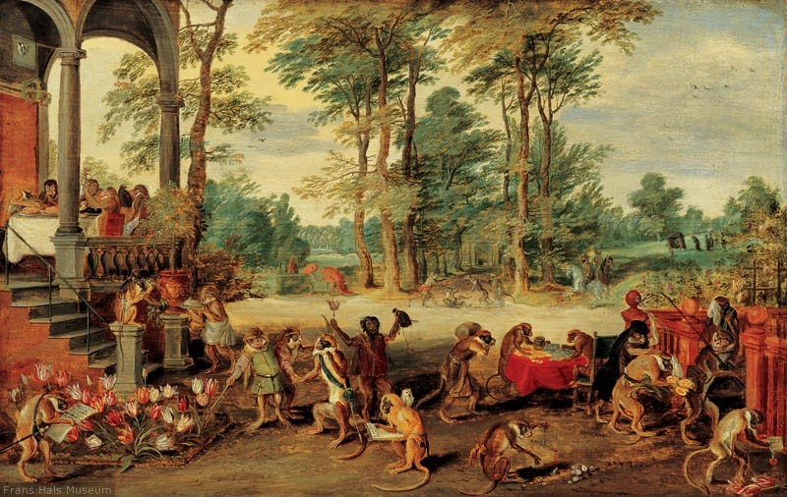
4.2. Lessons from History
4.2.1. The Dutch Tulip Crisis 1636-37
Caricature of investors’ behavior during the Dutch “Tulipmania” by Jan Brueghel the Younger (1640), Frans Hals Museum, Haarlem, Netherlands.
Notes:
2
Under the link of this video on Moodles you will find a link to a historical documentary on Dutch tulip fever, which contains further information.

Slide 28
4. International Financial Market Crises
4. International Financial Market Crises
4.1. The Ingredients of a Financial Market Crisis
4.2. Lessons from History
4.2.1. The Dutch Tulip Crisis 1636-37
4.2.2. The World Economic Crisis of 1929
Notes:
2
So much for this lecture!
___________________
Hellow everybody!
This is lesson 24 of the lecture “International Economics”.
I will present slides 28 through 49 of Chapter 4, “International Financial Crises”. We will talk about the stock market crash of 1929 and the resulting World Economic Crisis of the 1930s.
https://youtu.be/FXNziew6C9A

Slide 29
4.2. Lessons from History
4.2.2. The World Economic Crisis of 1929
From 1920 to 1929 the US-economy and the economies of many other industrialized countries experienced a period of fast economic growth – the “roaring twenties”.
Several factors favored this development:
    The economic aftermaths of the World War I (1914-18) were overcome in most countries; the world economy was enjoying a period of relative stability. International trade regained momentum.
    New technologies spread: Households were electrified. This had very similar effects as the connection of households to the internet in the 1990s: new products such as electrical household appliances, telephones and radios could be sold to households.
    The principles of mass production, developed by Henry Ford, made production costs considerably cheaper.
    Emergence of the automobile industry, aviation industry, film industry.
    These new technologies unleashed investor fantasies about new profit opportunities. New joint stock companies were founded and sold on the stock market at great profit. More and more people started investing in stocks.
Notes:
2

Slide 30
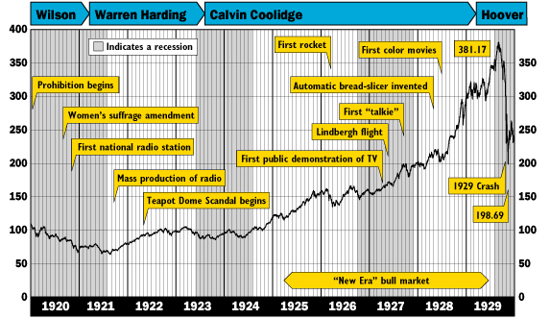
The Development of the Dow Jones Index Before and After the World Economic Crisis of 1929
Notes:
2
This diagram shows the development of the Dow Jones stock market index in the so-called "Roaring Twenties" of the past century. The Dow Jones stock market index is the average value of the 30 largest stock companies that are traded on the New York Stock Exchange, also known as Wall Street.
The technological progress just described led to higher profits for the stock corporations so that the prices continued to rise with the beginning of the 20s.
This led to speculation on a further price increase, so that the demand for shares continued to rise.

Slide 31
Standard & Poors 500 Index
(Inflation Corrected Prices = 2004)
The upward trend in corporate profits in the 20s gave rise to further profit growth expectations.
Notes:
2
This diagram shows the development of the average company earnings per share of the 500 stock companies included in the Standard & Poor's 500 index. This index covers the 500 largest companies that are traded on the NY Stock Exchange.
This strong upward trend in corporate profits in the course of the 20s gave rise to further profit growth expectations.

Slide 32
Standard & Poors 500 Index
(Inflation Corrected Prices = 2004)
Notes:
2
This chart shows additionally the average stock price of the 500 companies in the S&P Index.
As is obvious, stock prices rose much faster than the average corporate earnings per stock.

Slide 33
Standard&Poors Cyclically Adjusted Price/Earnings Ratio
January 1880 – November 2013
http://www.econ.yale.edu/~shiller/data/ie_data.xls
The all time average of the S&P 500 P/E-ratio is 16,5 (what corresponds to an average earnings yield of 6,0%). As the development of the S&P 500 P/E-ratio shows, the bubbles which led to the world economic crises of 1929 and the dot.com-crisis of 2000 had been periods with very strong growth of the P/E-ratio.
- 33 -
Prof. Dr. Rainer Maurer
Notes:
33
If you divide the earnings per share by the share price, the resulting number is called the price-earnings ratio.
As this diagram shows, the price / earnings ratio rose very sharply during the 1920s at CLICK. That means that stock prices rose much faster than the earnings of the companies' stocks.
With the stock market crash of October 1929, share prices began to collapse, so that the P / E ratio also crashed.
As the diagram shows, there was a very similar development in the 1990s, which led to the bursting of the internet bubble, in April 2000.

Slide 34
4.2. Lessons from History
4.2.2. The World Economic Crisis of 1929
The American central bank, the Fed, as well as major European central banks injected a lot of money after World War I and in the course of the twenties into their economies.
This led to an increased creation of money backed credits by commercial banks.
Notes:
2

Slide 35
4.2. Lessons from History
4.2.2. The World Economic Crisis of 1929
Start of Expansionary Monetary Policy by the Federal Reserve
Notes:
2
The red line in this graph shows the development of the American money supply.
As is observable , CLICK, there was a sharp increase in the money supply after the end of the First World War.
The green line shows the development of nominal GDP; the blue line shows the development of real GDP.
The growing difference between the green and blue lines over the twenties, implies that this type of monetary policy caused first a strong inflationary increase in the prices of goods.

Slide 36
4.2. Lessons from History
4.2.2. The World Economic Crisis of 1929
Money growth stronger than growth of real income plus inflation
This indicates that a part of money supply has not flown in the demand for goods but in the demand for shares. => “Asset Inflation”
Notes:
2
In the course of the 20s money growth became stronger that the growth of nominal GDP.
This indicates that a part of money supply was not flowing in the demand for goods but in the demand for stocks, a phenomenon called “Asset price Inflation”

Slide 37
4.2. Lessons from History
4.2.2. The World Economic Crisis of 1929
These credits flew in part to private households as consumer credits and in part to investors.
  Consumer used credits to buy the newly available consumer goods like radios, refrigerators, kitchenware, cars. Therefore, many firms made large profits.
  Investors used credits to buy stocks of “new technology corporations”.
  Newly developed investment funds offered shares to normal households, which had so far not invested their savings in stock (“milkmaid hausse”)
  The supply of cheap credits induced even average households to buy stock financed with credits (“leveraged investment”).
The expansion of the demand for stock led to a boost of stock market prices:
  Between 1925 and 1929 the Dow Jones Index grew from about 100 to 380 = 39,6% growth per year.
  For example the share of the “Radio Corporation of America” (RCA) had a value of 5$ in 1925, which reached a value of 500 $ in 1929 = 216,2% growth per year.
Notes:
2
FTXT
milkmaid hausse = porters, waiters, newspaper men, shoeblacks and so on...

Slide 38
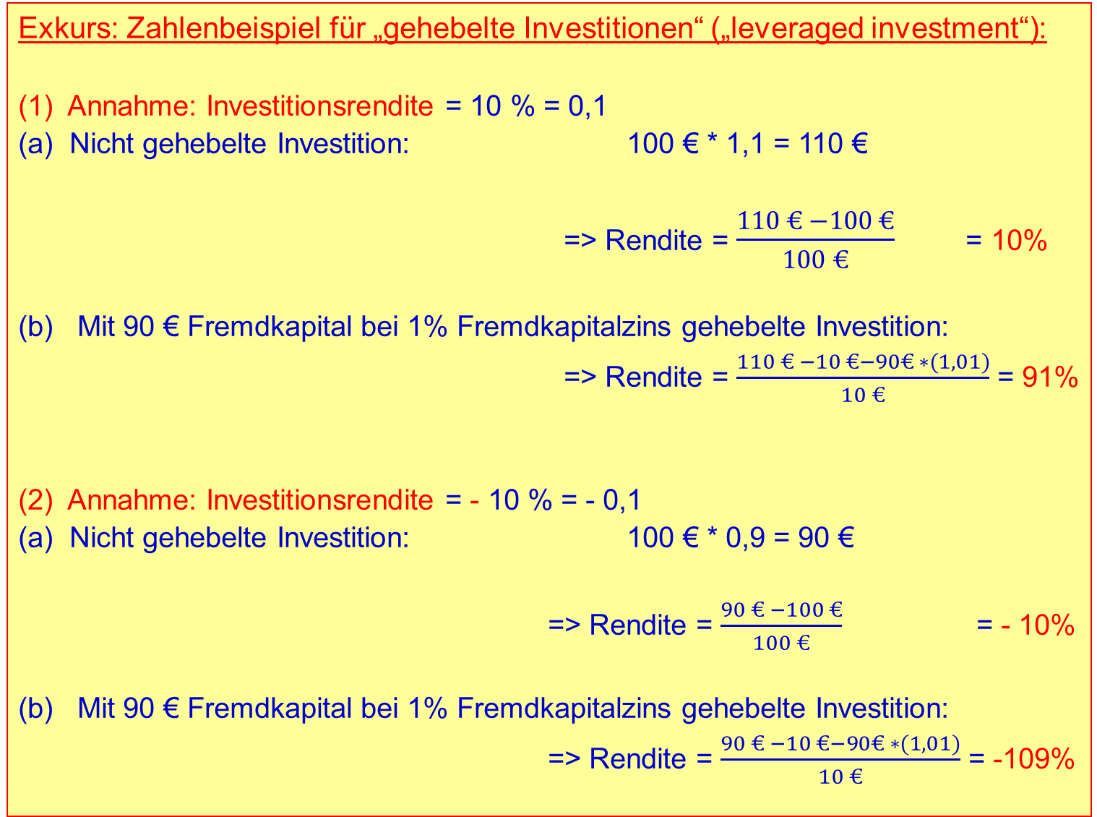
Prof. Dr. Rainer Maurer
- 38 -
Notes:
Prof. Dr. Rainer Maurer
38

Slide 39
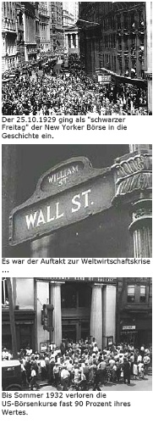
4.2. Lessons from History
4.2.2. The World Economic Crisis of 1929
In summer 1929 the American economy started to cool down, which was in part a result of a more restrictive monetary policy by the Fed, which had caused an increase of interest rates from 1927-29.
The stock market became more and more nervous in the course of the summer and finally started to collapse on Thursday the 24th of October.
By an intervention of four large commercial banks (J.P. Morgan, National City, Chase National, Guaranty Trust), which bought large volumes of stock, prices recovered.
But the following Monday selling began and on Tuesday a real panic started. The Dow Jones lost 13% (Monday) 12 % (Tuesday). Stock prices fell from their max at 381 to a level of 198 in a couple of days. Until April 1930 prices recovered up to a level of nearly 300.
However, the deterioration of the real economy caused then a steadily slide of prices until summer 1932, when the Dow Jones index reached the bottom with 41 index points.
Notes:
2
SEC = U.S. Securities and Exchange Commission
On October 24 ("Black Thursday"), the market lost 11 percent of its value at the opening bell on very heavy trading. The huge volume meant that the report of prices on the ticker tape in brokerage offices around the nation was hours late, so investors had no idea what most stocks were actually trading for at that moment, increasing panic. Several leading Wall Street bankers met to find a solution to the panic and chaos on the trading floor.[11] The meeting included Thomas W. Lamont, acting head of Morgan Bank; Albert Wiggin, head of the Chase National Bank; and Charles E. Mitchell, president of the National City Bank of New York. They chose Richard Whitney, vice president of the Exchange, to act on their behalf.
With the bankers' financial resources behind him, Whitney placed a bid to purchase a large block of shares in U.S. Steel at a price well above the current market. As traders watched, Whitney then placed similar bids on other "blue chip" stocks. This tactic was similar to one that ended the Panic of 1907. It succeeded in halting the slide. The Dow Jones Industrial Average recovered, closing with it down only 6.38 points for the day. The rally continued on Friday, October 25th, and the half day session on Saturday the 26th but, unlike 1907, the respite was only temporary.
The trading floor of the New York Stock Exchange in 1930, six months after the crash of 1929
Over the weekend, the events were covered by the newspapers across the United States. On October 28, "Black Monday",[12] more investors facing margin calls decided to get out of the market, and the slide continued with a record loss in the Dow for the day of 38.33 points, or 13%.
The next day, "Black Tuesday", October 29, 1929, about 16 million shares traded as the panic selling reached its crescendo. Some stocks actually had no buyers at any price that day ("air pockets"). The Dow lost an additional 30 points, or 12 percent,[13][14][15] amid rumors that U.S. President Herbert Hoover would not veto the pending Smoot–Hawley Tariff Act.[16] The volume of stocks traded on October 29, 1929 was a record that was not broken for nearly 40 years.[14]
On October 29, William C. Durant joined with members of the Rockefeller family and other financial giants to buy large quantities of stocks to demonstrate to the public their confidence in the market. But, their efforts failed to stop the large decline in prices. Due to massive volume of stocks traded that day, the ticker did not stop running until about 7:45 p.m. that evening. The market had lost over $30 billion in the space of two days which included $14 billion on October 29 alone

Slide 40
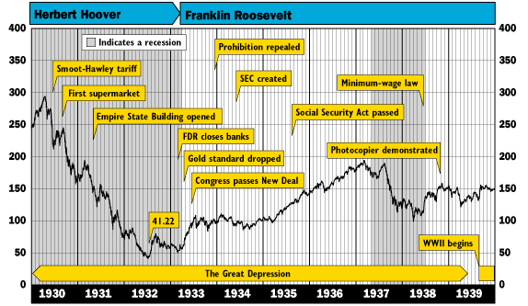
The Development of the Dow Jones Index Before and After the World Economic Crisis of 1929
Notes:
2
This chart shows the development of the Dow Jones Index after the crash of 1929.
Prices kept on falling until the year 1933. A full recovery of price took place after World War II.
Until then, there had never been such a sharp and long-lasting slump in stock prices.

Slide 41
4.2. Lessons from History
4.2.2. The World Economic Crisis of 1929
What was most severe, was the hardship which with this stock market crisis hit the real economy:
  Since many people – from business man to simple worker – had invested in stock, many people lost net wealth.
  Their lower net wealth led to lower demand for goods.
  In the short run, firms adjusted their supply of goods to the lower demand for goods, what led to a lower level of production.
  The decrease in production led to reduction in the firms’ demand for labor.
  The decrease in the demand for labor led to a tremendous increase in unemployment.
  Increasing unemployment led to even lower incomes of the largest part of the population, which caused a further reduction in the demand for goods.
  The typical Keynesian demand side recession evolved and gained strong momentum.
Notes:
2

Slide 42
4.2. Lessons from History
4.2.2. The World Economic Crisis of 1929
Prof. Dr. Rainer Maurer
- 42 -
Notes:
Prof. Dr. Rainer Maurer
42
This table shows how severe the following recession was. The unemployment rate rose over a period of 4 years, CLICK. In 1933, 25% of all American workers had become unemployed.
On the other hand, real GDP, KLICK, decreased at double-digit rates over a period of 3 years.
All three domestic expenditure components of GDP, household consumption, investment demand and government consumption, collapsed. CLICK

Slide 43
4.2. Lessons from History
4.2.2. The World Economic Crisis of 1929
Prof. Dr. Rainer Maurer
- 43 -
Notes:
Prof. Dr. Rainer Maurer
43
Other countries like Germany had similar experiences. CLICK
The crisis hit the entire world economy.

Slide 44
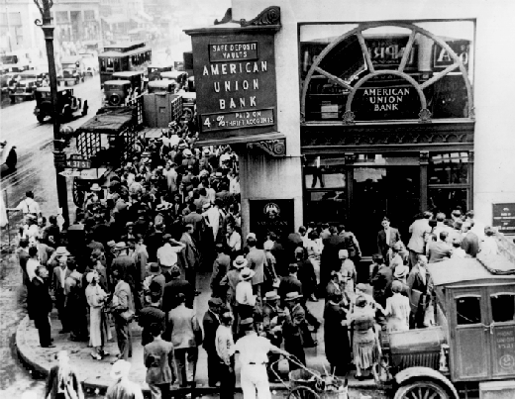
4.2. Lessons from History
4.2.2. The World Economic Crisis of 1929
The Fed did not turn around its restrictive monetary policy in the first month after the stock market collapse.
Only by summer 1933 did the Fed start to switch to a more expansionary monetary policy and decreased interest rates.
This was, however, much too late. Since many debtors, firms, investment funds and private households were unable to pay back their credits, a couple of banks had to declare bankruptcy.
As a consequence, bank runs took place, where depositors (creditors) wanted their money back (because they feared further bankruptcies).
Since the Fed was first not willing to help these banks with cheap central bank money credits, many banks failed: during the first 10 months of 1930, 744 US banks failed.
By 1933, depositors had lost $140 billion in deposits.
Notes:
2
Even banks that had in principle been solvent, became illiquid, because they had no access to short run cash from the central bank.

Slide 45
Restrictive monetary policy by the Fed caused deflation and deepened the recession!
Notes:
2
The red line of the diagram shows that after the outbreak of the crisis, CLICK, the US Federal Reserve strictly reduced the money supply, CLICK.
This reduction in credit supply cut off many commercial banks from the cash credits that they urgently needed in order to react to the bank run of their worried customers.
These commercial banks were illiquid and had to file for bankruptcy even though they were not actually over-indebted.

Slide 46
4.2. Lessons from History
4.2.2. The World Economic Crisis of 1929
Did the World Economic Crisis of 1929 exhibit the ingredients of a typical financial market crisis?
Initial Shock:
  Technological innovations: New technologies (power grid connection of households, electronics, mass production, automotive engineering) gave rise to fantasies: “New Era”, “This time it’s different”...
Positive Feedback Mechanism:
  Increase in demand for stocks by institutional investors caused by higher company profits. Increase in prices led to an expectation of further price increases. Expectation of further price increases led once again to an increase in the demand for stocks by households and investment funds and so on.
Notes:
2
FTXT

Slide 47
4.2. Lessons from History
4.2.2. The World Economic Crisis of 1929
Did the World Economic Crisis of 1929 exhibit the ingredients of a typical financial market crisis?
Funding Source:
  Expansionary monetary policy in interaction with the credit expansion of commercial banks supplied cheap credits, which boosted the demand for stocks.
Negative Shock:
  Gradual cooling-down of the American economy, probably caused by the more restrictive monetary policy of the Fed in the years 1927-29.
BBC2 Documentary 1929 The Great Crash 1929
https://www.youtube.com/watch?v=FXNziew6C9A
Notes:
2
FTXT
Under the moodle link of this lecture you will find a BBC documentary about the stock market crash of 1929.
https://www.youtube.com/watch?v=FXNziew6C9A

Slide 48
4. International Financial Market Crises
4. International Financial Market Crises
4.1. The Ingredients of a Financial Market Crisis
4.2. Lessons from History
4.2.1. The Dutch Tulip Crisis 1636-37
4.2.2. The World Economic Crisis of 1929
4.2.3. The Dot-com Crisis 2000
Notes:
2
So much for this lecture!

Slide 49
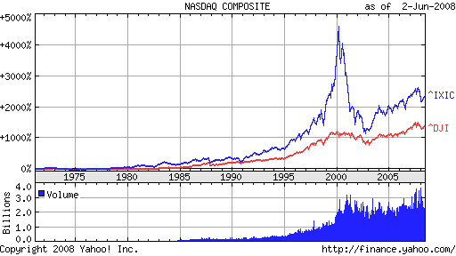
4.2. Lessons from History
4.2.3. The Dot-com Crisis 2000
The dot-com bubble (also IT-bubble) started somewhere around 1995 and burst in March 2000.
The bubble infected mainly the stock market prices of internet-, telecommunications-, and software-firms – the so called “New Economy”.
The prices of firms that be- longed to the “Old Economy” did not explode to the same degree, as a comparison of the NASDAQ Index (IXIC) with the Dow Jones Industrial Index (DJI) reveals.
Consequently, similar as the stock market bubble that led to the World Economic Crisis of 1929, the availability of new technologies and the “profit-fantasies” they caused started the bubble.
Notes:
2
NASDAQ = National Association of Securities Dealers Automated Quotations

Slide 50
4.2. Lessons from History
4.2.3. The Dot-com Crisis 2000
By the end of the year 2000 the NASDAQ-P/E-ratio was above 60 (= 1,6% “earnings yield”)
“New business models” for new eco-nomy corporations were created, pro-pagated and finally sold to investors.
Following these business models, the typical market structure of the new economy is characterized by network products. The corporation that grows fastest is able to set the network-standard and finally monopolize the market. Successful IT corporations like Microsoft had inspired this business model.
NASDAQ Price/Earnings Ratio
Consequently, not the profit of a new economy corporation stood at the center of interest, but the growth of its market share or customer base: “Get large or get lost!” was the motto of the day.
Some analysts even interpreted a large loss (the “capital burn rate”) as an indicator of a fast expanding market share and hence of the “long-run” profitability of a firm.
Notes:
2
Extremely high P/E ratios, but only those companies with positive Earnings are included!
Many “new market companies” suffered from heavy losses!
There was a “theory” / explanation why buying stock companies with very high losses per stock was profitable:
The “capital-burn-rate-theorem”: Network effects…
Betriebssystem: operating system
Anwendungssoftware: applications software

Slide 51
4.2. Lessons from History
4.2.3. The Dot-com Crisis 2000
The first corporations based on such business models, which were brought to the stock market by venture capital companies, provided their owners remarkable high price gains of 50% and more on the first trading day:
  When the German Corporation Siemens sold its subsidiary „Infineon“ at an issuing price of 35 €, the price reached a level of 85 € at the same day. (Today: 17,20 €.)
Such gains attracted the attention of the public. Even people that never cared much about the stock market, started to invest in stock.
The “chase” for new public offers of stocks became a popular sport.
In Germany two events stood at the beginning of this hype:
  The opening of the “Neue Markt”, the German equivalent to the NASDAQ, in March 1997.
  The initial public offering (IPO) of the German Telekom in November 1996, whose stocks were popularized as “people’s stock” (“Volksaktie”) by a large-scale TV-advertising campaign. (Issuing price 14,7€, high 104 € in March 2000, today: 15,04 €)
Notes:
2

Slide 52
4.2. Lessons from History
4.2.3. The Dot-com Crisis 2000
Notes:
2

Slide 53
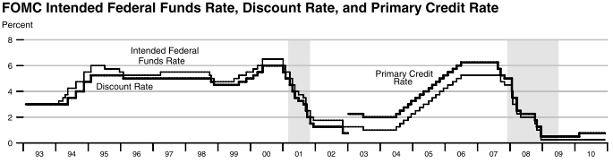
4.2. Lessons from History
4.2.3. The Dot-com Crisis 2000
Talking about the stock market became as popular as talking about famous football clubs or pop stars. Manager of New Economy corporations even became a kind of pop stars themselves.
A lot of people reallocated their savings and retirement provisions from low risk securities to stocks. US pension funds offered their clients the possibility to reallocate themselves their accounts among stocks, bonds and money market assets. Large price gains of stocks led more and more people to shift an important share of their retirement provision to stock funds.
Monetary policy in the USA and other countries did not actively fight the booming stock market: From February 2, 1995, to August 24, 1999, the Fed did not increase its target interest rate, with a one-time exception of 0,25 % in March 1997.
Prof. Dr. Rainer Maure
Notes:
2

Slide 54
Expansionary Monetary Policy
+ 45%
Notes:
2

Slide 55
Notes:
Der EONIA (Euro Overnight Index Average) ist der offiziell berechnete Tagesgeldzinssatz für den Euro. Er besteht aus dem gewichteten Durchschnitt der Zinssätze, die eine Gruppe größerer Institute im Euro-Währungsgebiet auf dem Interbankenmarkt für unbesicherte Übernachtkontrakte effektiv abgeschlossen haben und ist ein Per-Annum-Zinssatz nach der Methode act/360. Er wird von der Europäischen Zentralbank berechnet und trägt die WKN: 965994 /ISIN: EU0009659945. Zur Ermittlung des EONIA stellt eine Gruppe von 43 Banken (Panel-Banken) täglich bis spätestens 18:30 CET der Europäischen Zentralbank Daten über Umfang und durchschnittlichen Zinssatz der an diesem Tag vollzogenen ungesicherten Tagesgeldausleihungen zur Verfügung. Der von der EZB unter Eliminierung der jeweils 15 höchsten und tiefsten Werte ermittelte Durchschnittswert, welcher seit dem 3. September 2007 mit drei Nachkommastellen angegeben wird, wird daraufhin an Reuters weitergeleitet, so dass der EONIA zwischen 18:45 und 19:00 Uhr veröffentlicht werden kann. Da es sich bei den Daten, die die einzelnen Banken herausgeben, um sensible Informationen handelt, stellt die EZB als unabhängige Institution eine wichtige Voraussetzung zur Berechnung des EONIA dar.
EURIBOR: European InterBank Offered Rate ist der Zinssatz für Termingelder in Euro im Interbankengeschäft. Er wurde im Zuge der Einführung des Euros vom ACI als Alternative zum LIBOR am 1. Januar 1999 eingeführt und ersetzte in Deutschland zugleich den FIBOR (Frankfurt Interbank Offered Rate) als Referenzzinssatz bei Krediten und Anlageprodukten. Täglich melden bis zu 43 Kreditinstitute, darunter 10 deutsche Banken, Angebotssätze (Briefsätze) für Ein- bis Zwölfmonatsgelder um 11:00 Uhr Brüsseler Zeit an einen Informationsanbieter, der Durchschnittssätze ermittelt und auf Reuters (früher Moneyline Telerate, davor Bridge Telerate Seite 248) mit drei Nachkommastellen veröffentlicht, wobei die 13 Banken mit dem höchsten und niedrigsten Zinsangebot nicht in die EURIBOR-Berechnung einfließen. Dies soll dazu führen, dass Zinsausreißer nicht den Markt verfälschen. Für die Zinsberechnung gilt die für Geldmarktgeschäfte übliche Methode actual/360.

Slide 56
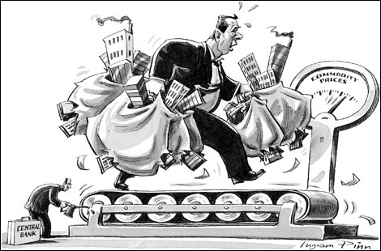

4.2. Lessons from History
4.2.3. The Dot-com Crisis 2000
Notes:
2

Slide 57
4.2. Lessons from History
4.2.3. The Dot-com Crisis 2000
From June 1999 to March 2000 the Fed increased its Federal Funds target rate successively from 5% to 6%.
In February 2000 the Dutch internet retailer Boo.com declared bankruptcy.
In March 2000 The US-financial magazine Barron’s published a list with 51 new economy corporations that were likely to declare bankruptcy over the next 12 month.
At the March 10 weekend most high-tech stock market indexes reached their peaks.
At Monday March 13 selling started. Until the end of March most high-tech indexes lost more than 25%.
Many New Economy corporations could no longer finance their losses by selling new stocks and had to declare bankruptcy.
The decline of the NASDAQ came not to a standstill until October of the year 2003.
Notes:
2

Slide 58
4.2. Lessons from History
4.2.3. The Dot-com Crisis 2000
Many people lost their savings and reduced their demand for goods. This caused a recession in most developed countries.
Contrary to the situation after 1929 (where the Fed reacted to late), the Fed (and many other central banks) under governor Allen Greenspan actively fought the recession and lowered their interest rates by injecting a lot of money to their economies.
The lower interest rates stabilized the demand for goods and – most likely – prevented the world economy from a severe recession as experienced after the stock market crash of 1929.
However, critics of this policy argue that the “cheap money” injected by the Fed from 2001 to 2005 caused the real estate bubble that led to the subprime crisis of 2007-9.
“subprime crisis” of our days.
Notes:
2

Slide 59
Expansionary Monetary Policy
+ 27%
+ 45%
Notes:
2

Slide 60
4.2. Lessons from History
4.2.3. The Dot-com Crisis 2000
Did the Dot-com Crisis of 2000 exhibit the ingredients of a typical financial market crisis?
Initial Shock:
  Technological innovations: New IT technologies (internet technology, internet based services, telecommunications, cellular phones) gave rise to fantasies: “New Economy”, “This time it’s different”
Positive Feedback Mechanism:
  Increase in demand for IT stocks by investments funds and private households led to an increase in stock market prices. increase in prices led to an expectation of further price increases. Expectation of further price increases led once again to an increase in the demand for IT stocks and so on.
Notes:
2

Slide 61
4.2. Lessons from History
4.2.3. The Dot-com Crisis 2000
Did the Dot-com Crisis of 2000 exhibit the ingredients of a typical financial market crisis?
Funding Source:
  Restructuring of portfolios: Pension funds and private households shifted their savings from (boring) low risk fixed rate securities and old economy stocks to the stocks of the (real hot) New Economy corporations. Monetary Policy did neither actively fuel not actively fight the bubble – until shortly before the end.
Negative Shock:
  Turnaround of monetary policy starting with June 1999.
  Bankruptcy of the first New Economy corporation in February 2000 and the resulting uncertainty in the face of the extraordinary stock market price level reached.
Notes:
2

Slide 62
4. International Financial Market Crises
4. International Financial Market Crises
4.1. The Ingredients of a Financial Market Crisis
4.2. Lessons from History
4.2.1. The Dutch Tulip Crisis 1636-37
4.2.2. The World Economic Crisis of 1929
4.2.3. The Dot-com Crisis 2000
4.2.4. The Subprime Crisis 2007-09
Notes:
2

Slide 63










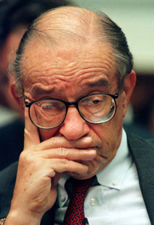





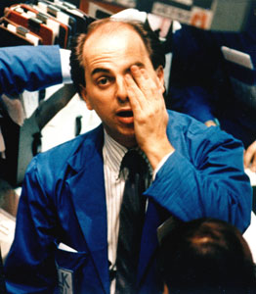



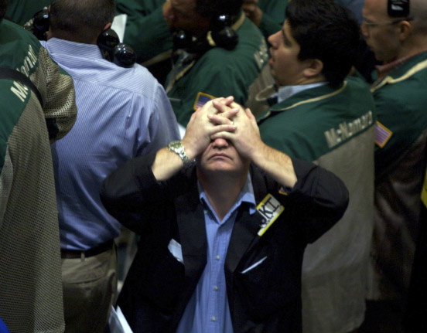

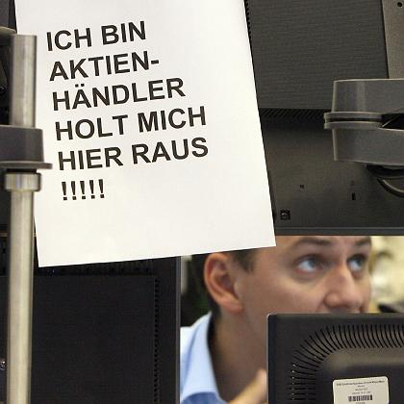




4.2. Lessons from History
4.2.4. The Subprime Crisis 2007-09
Notes:
2
NASDAQ = National Association of Securities Dealers Automated Quotations

Slide 64
4.2. Lessons from History
4.2.3. The Dot-com Crisis 2000
Notes:
2
NASDAQ = National Association of Securities Dealers Automated Quotations

Slide 65
4.2. Lessons from History
4.2.4. The Subprime Crisis 2007-09
As the following chart shows, the bubble that led to the subprime crisis (“housing bubble" in the following) started immediately after the Dot.dom bubble in the year 2000.
  From the 1991 to the end of 2000, the inflation corrected average yearly growth rate of housing prices in the US equaled 1,0%.
  From the 2000 to the end of 2006, the inflation corrected average yearly growth rate of housing prices in the US equaled 5,2%.
Notes:
2
NASDAQ = National Association of Securities Dealers Automated Quotations

Slide 66
The yearly real growth rate for the USA from 1991 – 2000 is 1,0 % from 2000 – 2006 is 5,2 %
Source: Office of Federal Housing Enterprise Oversight
Notes:
2
NASDAQ = National Association of Securities Dealers Automated Quotations

Slide 67
4.2. Lessons from History
4.2.4. The Subprime Crisis 2007-09
Comparing these data with the monetary policy data on the next chart shows that the acceleration of housing prices appeared at the same time when US monetary policy became expansionary at the beginning of the year 2001 in order to stabilize stock markets after the Dot.com-crash.
The chart shows also that the additional money that was injected by the Fed from 1989 to 1993, at the beginning of the Dot.com-bubble had only slightly been reduced in the period from 1993-2000.
Consequently, this money too was still in circulation.
After the crash of the Dot.com bubble this money too spilled over from the stock market to the housing market.
Many observers do therefore blame the Fed for being responsible of having started the US housing bubble that led to the subprime crisis too.
Notes:
2
NASDAQ = National Association of Securities Dealers Automated Quotations

Slide 68
Expansionary Monetary Policy
+ 27%
+ 45%
Notes:
2

Slide 69
4.2. Lessons from History
4.2.4. The Subprime Crisis 2007-09
But it was not the Fed that invested this money in the housing market.
And it was more money than just the 583 Billion US-Dollar that the Fed and commercial banks created between 1989 and 2004 that were invested in the housing market.
The total credit volume of the US mortgage credit market equaled 14,4 Trillion US-Dollar in the year 2007 (s. next chart).
Why did commercial banks grant so many mortgage credits to the US housing market?
Two explanations are in the discussion:
  Subsidization of mortgage credits by the US government with the help of Fannie Mae & Freddie Mac & Co.
  Financial innovations like CDOs (=Collateralized Debt Obligations) that led to the neglect of credit risks by banks.
Notes:
2
Fannie Mae = Federal National Mortgage Association
Freddie Mac = Federal Home Loan Mortgage Corporation
NASDAQ = National Association of Securities Dealers Automated Quotations

Slide 70
4.2. Lessons from History
4.2.4. The Subprime Crisis 2007-09
Notes:
2

Slide 71
As the development of outstanding US mortgage debt shows, the lending boom was driven by federal agencies (Freddie, Fanny & Co.), commercial banks and private mortgage pools (shifting money from the stock market to the mortgage market…)
Notes:
2

Slide 72
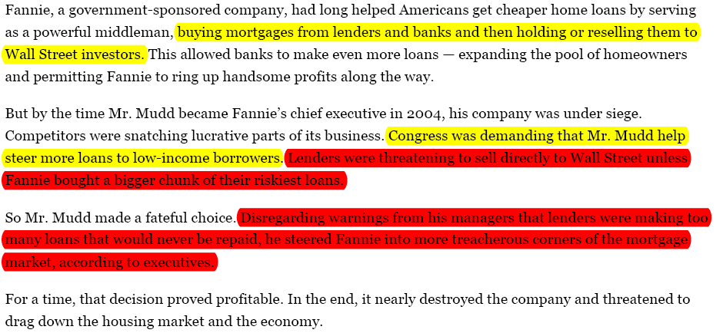
4.2. Lessons from History
4.2.4. The Subprime Crisis 2007-09
Notes:
2
NASDAQ = National Association of Securities Dealers Automated Quotations

Slide 73
4.2. Lessons from History
4.2.4. The Subprime Crisis 2007-09
Subsidization of mortgage credits by the US government with the help of Fannie Mae & Freddie Mac & Co:
  As the preceding chart shows, the so called “government sponsored enterprises” (Fannie Mae, Freddie Mac & 12 Federal Home Loan Banks) started the lending boom: They bought mortgage credits from banks and financed these purchases by selling bonds of their own, which were collateralized by the government. Thus they took over the default risk of mortgage banks and enabled them to lend even more money to real estate buyers.
  Once housing prices started rising, private lenders like commercial banks and private mortgage pools too fueled the lending boom.
  The typical real-estate-market-collateral-effect generated a positive feed-back mechanism:
    Higher housing prices increased the value of the mortgage credit collateral. This reduced the default-risk for lenders so that the value of securitized mortgage credit paper grow – generating large balance sheet gains and hence induced more lending leading to higher housing prices and so on…
Notes:
2
NASDAQ = National Association of Securities Dealers Automated Quotations

Slide 74
4.2. Lessons from History
4.2.4. The Subprime Crisis 2007-09
Financial innovations like CDOs (=Collateralized Debt Obligations) that led to the neglect of credit risks by banks.
  A CDO is a portfolio of mortgage credits sliced into different classes of risk.
  The “manufacturer”, typically an investment bank sells the classes to insurance companies, mutual funds, commercial banks, pension funds etc.
  The fixed rate return for each class contains a risk premium, which is highest for the equity tranche.
  Interest and amortization payments are first used to pay the owners of the senior tranche, if something is left, it will be used to pay the mezzanine tranche, if something is left, it will be used to pay the equity tranche.
Senior Tranche
(rated AAA)
Mezzanine Tranche
(rated AA to BB)
Equity Tranche
(unrated; “toxic waste”)
Notes:
2
NASDAQ = National Association of Securities Dealers Automated Quotations

Slide 75
4.2. Lessons from History
4.2.4. The Subprime Crisis 2007-09
If enough money flows back from the debtors, all tranches receive their money back:
Flowback of Credits (Amortization)
Senior Tranche
Mezzanine Tranche
Equity Tranche
Notes:
2
NASDAQ = National Association of Securities Dealers Automated Quotations

Slide 76
4.2. Lessons from History
4.2.4. The Subprime Crisis 2007-09
If not enough money flows back from the debtors, the equity tranche will first not be served.
Flowback of Credits (Amortization)
Senior Tranche
Senior Tranche
Mezzanine Tranche
Equity Tranche
Notes:
2
NASDAQ = National Association of Securities Dealers Automated Quotations

Slide 77
4.2. Lessons from History
4.2.4. The Subprime Crisis 2007-09
If even less money flows back from the debtors, the mezzanine tranche too will not be served.
Flowback
Senior Tranche
Senior Tranche
Mezzanine Tranche
Equity Tranche
Notes:
2
NASDAQ = National Association of Securities Dealers Automated Quotations

Slide 78
4.2. Lessons from History
4.2.4. The Subprime Crisis 2007-09
If even less money flows back from the debtors, the senior tranche also will not be fully served:
Flowback
Senior Tranche
Senior Tranche
2%
Mezzanine Tranche
5%
  To compensate investors for the higher default risk buyers of the equity and mezzanine tranche receive higher interest payments.
  For example…
Equity Tranche
8%
Notes:
2
NASDAQ = National Association of Securities Dealers Automated Quotations

Slide 79
4.2. Lessons from History
4.2.4. The Subprime Crisis 2007-09
The evaluation of the price of the various tranches of a CDO relies on complex mathematical models, like the “Gaussian coupola model”.
When real estate prices (the collaterals of these CDOs) started to fall by the end of 2006, many investors did no longer trust in these complex models.
The market price of CDOs imploded and the CDO market virtually collapsed.
Now, not even the “senior tranches” are marketable any longer.
Creditors (like insurance companies, mutual funds, commercial banks, pension funds) had to write off their CDO investments.
These generated “black holes” in their balance sheets, which led to the bankrupt of many investors, among them well known banks like New Century, Sachsen LB, IKB, Aegis Mortgage, Northern Rock, Bear Sterns, AIG, Lehman Brothers, Washington Mutual ,Wachovia…
Notes:
2
NASDAQ = National Association of Securities Dealers Automated Quotations

Slide 80
4.2. Lessons from History
4.2.4. The Subprime Crisis 2007-09
The Balance Mechanics of Bankruptcy:¹⁾:
Bank Balance Sheet
Assets | Liabilities
Assets
Liabilities
¹⁾ “Bankruptcy” goes bank to the Italian expression „banca rotta“ and literally means „broken bank“.
Notes:
2
NASDAQ = National Association of Securities Dealers Automated Quotations

Slide 81
4.2. Lessons from History
4.2.4. The Subprime Crisis 2007-09
The Balance Mechanics of Bankruptcy:
Bank Balance Sheet
Assets | Liabilities
Cash Reserves
Deposits (Cash from the Central bank, Deposit Accounts, Savings Deposits, Time Deposits, etc.)
Credits to households and firms (non-banks)
Securities
Own Capital
Notes:
2
NASDAQ = National Association of Securities Dealers Automated Quotations

Slide 82
4.2. Lessons from History
4.2.4. The Subprime Crisis 2007-09
The Balance Mechanics of Bankruptcy:
Bank Balance Sheet
Assets | Liabilities
Cash Reserves
Deposits (Cash from the Central bank, Deposit Accounts, Savings Deposits, Time Deposits, etc.)
Credits to households and firms (non-banks)
Capital loss of securities leads to loss of own capital.
Securities
Remaining Value of Securities
Own Capital
=> No bankruptcy!
=> But not enough own capital!
=> Problem with bank supervision!
Notes:
2
NASDAQ = National Association of Securities Dealers Automated Quotations

Slide 83
7. Die Subprime-Krise
7.2. Der Ablauf der Krise
The Balance Mechanics of Bankruptcy:
Bank Balance Sheet
Assets | Liabilities
Cash Reserves
Deposits (Cash from the Central bank, Deposit Accounts, Savings Deposits, Time Deposits, etc.)
Credits to households and firms (non-banks)
Capital loss of securities goes on…
Remaining Value
Uncovered Deficit
Bankruptcy!
Notes:
2
NASDAQ = National Association of Securities Dealers Automated Quotations

Slide 84
4.2. Lessons from History
4.2.4. The Subprime Crisis 2007-09
15.September 2008: Lehman Brothers Bankruptcy
This failure of some of the most well reputed financial market institution led to widespread distrust among banks.
As a consequence the risk premiums on the market for interbank credits reached extraordinary highs.
Instead of lending money to each other, liquid banks invested their money in (low-risk) treasury bonds, driving down the short term treasury bonds rate and driving up the interbank offered rate (LIBOR).
This “credit crunch” was spilling over to the “real economy”, where small and medium firms have increasing difficulties of financing investment with the help of bank credits.
Notes:
2
NASDAQ = National Association of Securities Dealers Automated Quotations

Slide 85
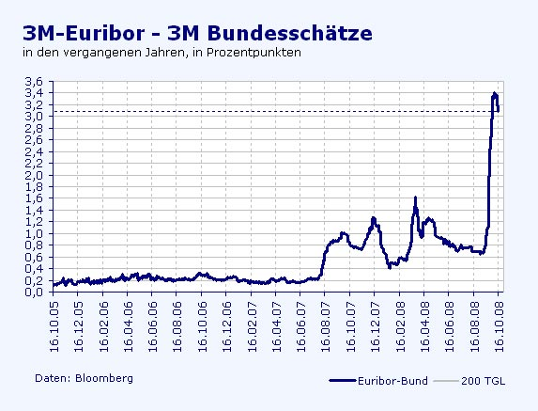
4.2. Lessons from History
4.2.4. The Subprime Crisis 2007-09
15.September 2008: Lehman Brothers Bankruptcy
Notes:
2
NASDAQ = National Association of Securities Dealers Automated Quotations

Slide 86
15.September 2008: Lehman Brothers Bankruptcy
Notes:
2
NASDAQ = National Association of Securities Dealers Automated Quotations

Slide 87
4.2. Lessons from History
4.2.4. The Subprime Crisis 2007-09
Prof. Dr. Rainer Maurer
- 87 -
Notes:
Prof. Dr. Rainer Maurer
87

Slide 88
4.2. Lessons from History
4.2.4. The Subprime Crisis 2007-09
Prof. Dr. Rainer Maurer
- 88 -
Notes:
Prof. Dr. Rainer Maurer
88
Extension of short-time working benefits

Slide 89
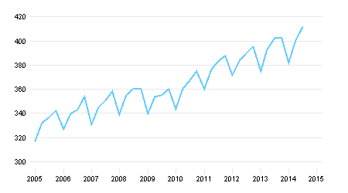
4.2. Lessons from History
4.2.4. The Subprime Crisis 2007-09
Private Consumption in Current Prices, Billion Euro
Prof. Dr. Rainer Maurer
- 89 -
Quelle: Statistisches Bundesamt
Notes:
Prof. Dr. Rainer Maurer
89
https://www.destatis.de/DE/ZahlenFakten/Indikatoren/Konjunkturindikatoren/Konjunkturindikatoren.html

Slide 90
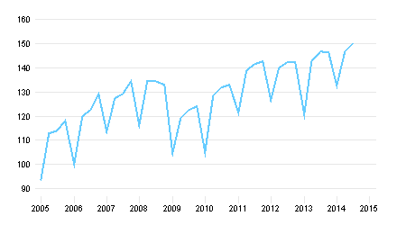
4. The Keynesian Model and its Policy Implications
4.5.4. Case Study: Economic Policy in the Great Recession
Gross Investment in Current Prices, Billion Euro
Prof. Dr. Rainer Maurer
- 90 -
Quelle: Statistisches Bundesamt
Notes:
Prof. Dr. Rainer Maurer
90
https://www.destatis.de/DE/ZahlenFakten/Indikatoren/Konjunkturindikatoren/Konjunkturindikatoren.html

Slide 91
4.2. Lessons from History
4.2.4. The Subprime Crisis 2007-09
The expenditure account of GDP show the components of the demand for domestic goods:
  Y = C + I + G + EX – IM
  <=> BIP = Consumption
  + Gross Investment
  + Government Consumption
  + Exports
  - Imports
“Net Exports”
Prof. Dr. Rainer Maurer
- 91 -
Notes:
Prof. Dr. Rainer Maurer
91

Slide 92
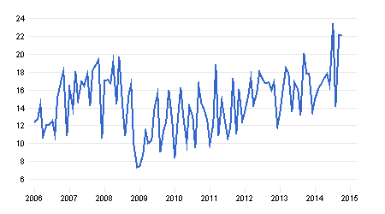
4.2. Lessons from History
4.2.4. The Subprime Crisis 2007-09
Exports ./. Imports in Current Prices, Billion Euro
Prof. Dr. Rainer Maurer
- 92 -
Quelle: Statistisches Bundesamt
Notes:
Prof. Dr. Rainer Maurer
92

Slide 93
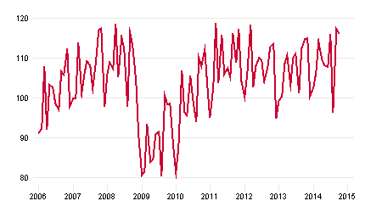
4.2. Lessons from History
4.2.4. The Subprime Crisis 2007-09
Production in Manufacturing, 2005 = 100
As postulated by the Keynesian model firms adjust their production in the short-run to the demand for goods.
Prof. Dr. Rainer Maurer
- 93 -
Quelle: Statistisches Bundesamt
Notes:
Prof. Dr. Rainer Maurer
93

Slide 94
4.2. Lessons from History
4.2.4. The Subprime Crisis 2007-09
As the data reveal, the recession was mainly caused by a reduction of investment and export demand.
The reason for the reduction of investment and export demand was the bursting of a speculative bubble on the US real estate market.
The causal chain behind the development is relatively complex, as the following chart shows:
Prof. Dr. Rainer Maurer
- 94 -
Notes:
Prof. Dr. Rainer Maurer
94

Slide 95
The Spill over of the Subprime Crisis to the Real Economy
USA
Germany
Decrease in Real Estate Prices
Loss of Credit Receivables of US Banks
Loss of Credit Receivables of Germ. Banks
Net Wealth Loss of Households
Reduction in Credit Supply by US Banks
Reduction in Credit Supply by Ger. Banks
German Consumption Relatively Stable
Reduction in Con-sumption Demand
Reduc-tion of Produc-tion in Ger-many
Reduction in Investment Demand
Reduction in Investment Demand
Reduction of Export Demand
Reduction in Demand for Consumption and Investment Goods from Germany
- 95 -
Notes:
Prof. Dr. Rainer Maurer
95

Slide 96
4.2. Lessons from History
4.2.4. The Subprime Crisis 2007-09
Did the Subprime Crisis exhibit the ingredients of a typical financial market crisis?
Initial Shock:
  Monetary policy & financial market innovations:
    Expansionary monetary policy in response to the Dot.com crash at the beginning of the year 2000.
    Development of CDOs as “modern” instruments of “high-tech” risk management.
Positive Feedback Mechanism:
  Credit induced increase in housing demand by private households led to an increase in housing prices. Increase in housing prices led to a higher value of mortgage collaterals. Higher collateral prices led to increased market prices for securitized mortgage debt instruments and CDOs. This induced even more credit supply to the housing market. This led to even higher housing prices…
Notes:
2

Slide 97
4.2. Lessons from History
4.2.4. The Subprime Crisis 2007-09
Did the subprime crisis exhibit the ingredients of a typical financial market crisis?
Funding Source:
  Restructuring of portfolios: Commercial banks, private and institutional investors reallocated money withdrawn from the stock marked to the real estate credit market.
  Increased money supply by the Fed.
Negative Shock:
  Turnaround of monetary policy in the years 2005 - 06.
  Bankruptcy of the first US mortgage bank in 2007.
Notes:
2

Slide 98
4. International Financial Market Crises
4. International Financial Market Crises
4.1. The Ingredients of a Financial Market Crisis
4.2. Lessons from History
4.2.1. The Dutch Tulip Crisis 1636-37
4.2.2. The World Economic Crisis of 1929
4.2.3. The Dot-com Crisis 2000
4.2.4. The Subprime Crisis 2007-09
4.2.5. The East Asian Financial Market Crisis 1997-98
Notes:
2
Hello everybody!
This is lesson 25 of the lecture “International Economics”.
I will discuss slides 98 to 122 of Chapter 4 “International Financial Crises”. This lesson is about the so-called "East Asian financial market crisis that took place between 1997 and 98".

Slide 99
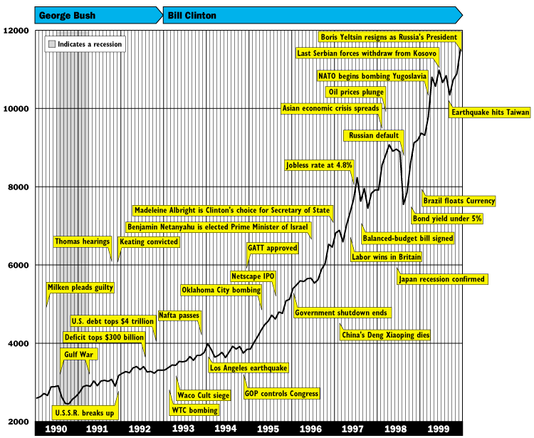

Notes:
2
I have already addressed East Asian economic history in connection with various trade policy concepts in Chapter 1. The so-called “East Asian tiger states” succeeded in starting a growth catch-up process based on the concept of “export-oriented industrialization”, which, increased significantly the per capita income and the real wages of these countries in the course of the eighties and nineties of the last century.
An important motor in this catch-up process was an investment boom, which triggered investment ratios between 20 and 30% of the gross domestic product in these countries.
This investment boom was made possible by the opening of the capital market of the countries to foreign investors in accordance following the concept of “export-oriented industrialization”.
However, this investment boom did not take place not without disruptions. As this chart of the Dow Jones Index shows, there was a global stock market slump in 1998, KLICK, which was related to the economic development, KLICK, in East Asia.
This slump in the American stock market was however overcome in the same year, because the American central bank, followed by other central banks, reacted very quickly by easing monetary policy.
This reaction by the Federal Reserve was ironically referred to as the "Greenspan Put" after its then President, Alan Greenspan, because it signaled to equity investors that the US Federal Reserve is providing monetary policy to hedge share prices against excessive falls. This type of monetary policy remains highly controversial until today. Many market observers blame it for fueling of the so-called “Internet speculative bubble”, which then burst in the spring of the year 2000.

Slide 100
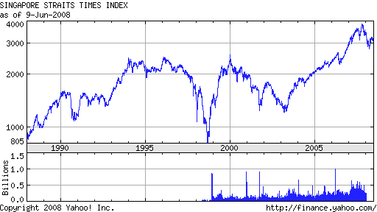
Notes:
2
As this chart shows based on the East Asian share index called “Singapore Straits Times”, the East Asian economic crisis began already in the year 1997, KLICK, but was already overcome by the year 1999.

Slide 101
4.2. Lessons from History
4.2.5. The East Asian Financial Market Crisis 1997-98
What were the causes of the East Asian Crises?
  During the 80s the strong growth of East Asian economies (South Korea Thailand, Philippines, Malaysia, Hong Kong, Indonesia) was financed by high domestic savings. At the beginning of the 90s they opened their capital markets for foreign investment.
    This marked the start of a massive acceleration of global financial integration.
    The inflowing capital caused massive price gains in East Asian stock and real estate markets (“East-Asia Boom”).
    Following this boom, international investors became very opti-mistic for the East Asian Economies and bought not only stock but offered also a lot of credits to East Asian banks and firms. Until 1997 they attracted more than half of total capital inflow to developing countries.
    East Asian banks borrowed from international investors and lent this money to domestic firms collateralized by the growing value of the real estate wealth of these firms.
Notes:
2
KLICK During the 1980s, countries, which practiced the concept of export-oriented industrialization like South Korea Thailand, Philippines, Malaysia, Hong Kong and Indonesia experienced a strong growth of their per capita income, which was first was financed by their high domestic savings.
At the beginning of the 90s they opened their capital markets for foreign investment.
… FTX
KLICK
KLICK
KLICK
KLICK

Slide 102
4.2. Lessons from History
4.2.5. The East Asian Financial Market Crisis 1997-98
  A fixed exchange rate policy against the US-$ by East Asian Central Banks reinforced foreign investment, because it sug-gested the “absence of exchange rate risk” for many investors.
  Affluent credits encouraged East Asian firms to invest in more and more risky and less attractive investment opportunities.
    Despite of their low labor costs, East Asian industries (especially mechanical and electrical machinery) became one of the most capital intensive industries in the world.
    Active industrial policies by governments increased the “willingness” of banks to support such investments.
  In the course of time more and more firms had problems to pay back their debt, because the commercial success of their investments failed.
  Domestic debtors (=firms) got more and more stuck in trouble.
Notes:
2
FTX

Slide 103
4.2. Lessons from History
4.2.5. The East Asian Financial Market Crisis 1997-98
  Banks had to prolong credits to firms in order to prevent a bankruptcy of these firms:
    Banks started to finance long-term domestic loans to firms with foreign, short-term interest-credits.
    This caused two kind of discrepancies:
      Maturity Discrepancy: (long-term loans / short-term liabilities)
      Currency Discrepancy: (loans in domestic currency / liabilities in foreign currencies (primarily US-$).
    As a consequence, the structure of the balance-sheets of banks deteriorated.
Notes:
2
FTX

Slide 104
4.2. Lessons from History
4.2.5. The East Asian Financial Market Crisis 1997-98
  This scenario implied that East Asian Economies had become vulnerable against higher interest rates:
    Given the highly indebted domestic firms an increase in the domestic interest rates by central banks (= decrease in money supply by central banks), would have made it even more difficult for the commercial banks to refinance their “troubled” credits.
    Therefore, a higher domestic interest rate would have increased the pressure for domestic banks to borrow abroad or increase their interest on bank credits.
  Therefore more and more international speculators believed that the East Asian central banks were not able to defend the fixed exchange rates of their currencies by increasing the their interest rates.
Notes:
2
FTX

Slide 105
4.2. Lessons from History
4.2.5. The East Asian Financial Market Crisis 1997-98
  As a consequence, they started to attack East-Asian central banks, by speculating against East Asian currencies:
  They sold East Asian currencies on the forward market (say 2$₩), in the hope of a depreciation of the spot exchange rate (say 1$₩), such that they could buy 1₩ on the spot market for 1$ and sell it for 2$ at the forward market based on their forward contracts.
    This caused however the forward exchanges rate to depreciate. This made foreign investments more attractive, as the interest rate parity equation shows:
    Demand for foreign investments, however, raises demand for foreign currencies and therefore causes depreciation pressure for the spot rate of the domestic currency e$_{₩,t}↓ below the exchange rate target ē$₩> e$_{₩,t.}
    To prevent this, the central banks had to increase the domestic interest rate: i_{₩,t,t+1}↑.
(1€ *e$_{₩,t}
* (1+i_{$,t,t+1})
↓
1€ * (1+i_{₩,t,t+1}) =
↓
/ f$_{₩,t+1} )
<
↓
Notes:
2
The strikethrough W is the symbol of the South Korean currency "Wong".

Slide 106
4.2. Lessons from History
4.2.5. The East Asian Financial Market Crisis 1997-98
  Higher domestic interest rates increased the refinancing problems of the domestic commercial banks and as a consequence worsened the (maturity- and currency-) structure of their balance sheets.
  Now international investors became alarmed, and refused to roll-over short-term credits of East Asian banks.
    Banks experienced severe problems in refinancing their long-term credits to firms.
    Firms with maturing credit lines had problems in finding new credit supplies.
    => Massive political pressure towards central banks to lower interest rates.
Notes:
2
FTX
“Now international investors became alarmed, and refused to roll-over short-term credits of East Asian banks.”
=> More restrictive monetary policy (= less central bank credits) increases the costs of refinancing credits by bank and by firms.
=> This increases the risk of default of banks and firms.

Slide 107
4.2. Lessons from History
4.2.5. The East Asian Financial Market Crisis 1997-98
  Given this pressure, more and more East Asian central banks gave up their exchange rate target and started to support the domestic private sector with lower interest rates.
  As a consequence, exchange rates of East Asian currencies towards the US-$ depreciated massively.
  Currency speculators had won their attack against central banks: They bought East Asian currencies with dollar at the low (depreciated) spot market rates (say 1$₩) and sold them at their high forward rates against dollar (say 2$₩) and made profit (here 1$).
  For the East Asian Banks the currency discrepancy became a a problem now:
    Since most banks had accepted $-denominated credits, their debt burden (say D$) measured in domestic currency increased by the depreciation of the domestic currency: (D$ / e$₩ ↓) ↑
    Now not only private firms were overindebted, but also private banks.
Notes:
2
FTX

Slide 108
4.2. Lessons from History
4.2.5. The East Asian Financial Market Crisis 1997-98
The effect of a depreciation of domestic currency on the balance sheet of the East Asian Banks:
Bank Balance Sheet
Assets | Liabilities
…assets outstanding against domestic firms = 100 ₩
…liabilities against foreign creditors = 200 $ / 2$₩
= 100 ₩
Notes:
2
This graph shows the structure of a bank balance sheet, in which the assets, KLICK, consist of loans to domestic companies and the liabilities, KLICK, consist of credits from foreign investors.
As the numerical example shows, this balance is just balanced at an exchange rate of 2 $ per ₩.

Slide 109
4.2. Lessons from History
4.2.5. The East Asian Financial Market Crisis 1997-98
The effect of a depreciation of domestic currency on the balance sheet of the East Asian Banks:
Bank Balance Sheet
Assets | Liabilities
… liabilities against foreign creditors = 200 $ / 1$₩
= 200 ₩
… liabilities against foreign creditors = 200 $ / 2$₩
= 100 ₩
…assets outstanding against domestic firms = 100 ₩
… liabilities against foreign creditors = 200 $ / 1$₩
= 200 ₩
…depreciation of domestic currency from 2$₩ to 1$₩ causes bankruptcy!
Deficit => Bankruptcy
Notes:
2
However, if a depreciation of the domestic currency happens, KLICK, let‘s say from 2$₩ to 1$₩, KLICK, this depreciation causes a bankruptcy, because the liabilities of the bank grow above the assets measured in domestic currency.
Without government support, the bank becomes bankrupt.

Slide 110
4.2. Lessons from History
4.2.5. The East Asian Financial Market Crisis 1997-98
  As a consequence international investors started to panic.
  They drew back as much credits as possible, so that the international credit supply to East Asian economies vanished.
  Numerous firms and banks went bankrupt.
  The financial market crisis became a perfect storm.
  Contagion effects to countries with a similar credit structure emerged and led to credit withdrawals from Russia and several Latin American countries.
  A regional financial market crises was on the brink to become a worldwide financial market crises.
  However an easing of monetary policy by the Fed and several Euro-pean central banks massively increased the credit supply to the world capital markets and helped to support many debtors in trouble.
Notes:
2

Slide 111
Notes:
As this diagram shows, the consequences of the East Asian financial market crisis were soon overcome in East Asia as well.
After a brief slump, CLICK, GDP per capita recovered from the shock.
The long-term successful development path of "export-oriented industrialization" became not permanently blocked by the crisis.

Slide 112
Notes:
As this diagram shows, the very high investment rates decreased somewhat after the crisis, CLICK.
Compared to other countries, however, they were still on a high level.

Slide 113
Notes:
The depreciation of the currencies of the East Asian countries, which had been triggered by the speculators, made their goods cheaper on the world market and, CLICK, thus even led to an increase in the export quotas after the crisis.
This helped the real economy of the East Asian countries to recover relatively fast from this financial market shock.

Slide 114
Time Table of the East Asian Financial Market Crisis (1)
  May 1997: The Central Bank of Thailand had to give up its exchange rate target => Strong depreciation of the Thai currency.
  July 1997: The Philippine and Malaysian Central banks follow.
  August 1997:
    42 Thai banks go bankrupt.
    Indonesia suspends the convertibility of its currency.
  October 1997:
    Indonesia demands 10 Mrd. $ financial help from the International Monetary Fund (IMF).
    Even the until then stable Hong Kong Dollar gets under depreciation pressure.
    Risk premia of Latin American government Bonds increase significantly
Notes:
2

Slide 115
Time Table of the East Asian Financial Market Crisis (2)
  November 1997: South Korea suspends the convertibility of its currency and demands IMF financial help.
  August 1998:
    IMF demands a redesign of the financial sector in exchange for financial help.
    2nd Russian Crisis: The IMF grants 21 Mrd. $ financial help.
  September 1998:
    The Crisis spills over to Latin America: Brazil gets 18 Mrd. $ IMF financial help.
    Malaysia imposes a regime of rigid capital market controls.
    US-Central Bank (Fed) lowers interest rates massively. => Depreciation pressures ease & International Economics stabilize.
Notes:
2

Slide 116
4.2. Lessons from History
4.2.5. The East Asian Financial Market Crisis 1997-98
Did the East Asian Financial Market Crisis exhibit the ingredients of a typical financial market crisis?
Initial Shock:
  Financial Market Deregulation: East Asian countries opened their capital markets for foreign investors.
Positive Feedback Mechanism:
  Foreign investors increased the demand for stock and real estate assets in East Asian countries. This caused an increase in prices, which then led to the expectation of further price increases. Expectation of further price increases led once again to an increase in the demand for stock and real estate assets.
Notes:
2
Here, too, one can ask again whether this financial market crisis contained the typical components of a financial market crisis? CLICK

Slide 117
4.2. Lessons from History
4.2.5. The East Asian Financial Market Crisis 1997-98
Did the East Asian Financial Market Crisis exhibit the ingredients of a typical financial market crisis?
Funding Source:
  Increase in foreign investment due to the economic opening for international capital.
Negative Shock:
  Currency attack of international speculators on East Asian currencies at the beginning of 1997.
Notes:
2

Slide 118
4.2. Lessons from History
4.2.5. The East Asian Financial Market Crisis 1997-98
Digression: The economics of a currency attack (1)
Necessary preconditions:
1. The central bank has a declared currency target: ē$¥ (say 2$¥ )
2. Speculative attackers have good reason to expect that the central bank is not able to defend this target (e.g. the central bank is not independent and political pressure groups are not willing to accept the economic consequences of defending the currency target).
The calculus of the speculative attackers:
Example: If the attackers firmly expect to be able to bring the spot rate of period t+n down to E_{t}(e$_{¥,t+n}) = 1$ and the current forward rate for period t+n equals f$_{¥,t,t+n}= 2$, they can sell 1¥ at this forward rate and will receive 2$ in period t+n in exchange for 1¥. If their expectation fulfills and the spot rate in period t+n equals e$_{¥,t+n}= 1$ , they can take these 2$ and buy 2¥. With this money, they can finance the 1¥ they have given away for the 2$ and keep 1¥ back as their profit from this deal (what equals 1$ at the new spot market rate e$_{¥,t+n}= 1$).

Slide 119
Digression: The economics of a currency attack (2)
The behavior of the central bank:
(1) If speculative attackers sell large volumes of ¥ forward, the forward rate at time t will get under depreciation pressure: f$_{¥,t,t+n} ↓
(2) This will disturb the interest arbitrage equation:
(1+i¥ ) < [ e$_{¥,t}* (1+i$ ) / f$_{¥,t,t+n} ↓ ] ↑
so that investment in ¥-assets is less profitable than investment in $-assets.
(3) This leads to an outflow of ¥-savings in $-assets. This causes an increase in ¥-supply and $-demand at the spot market, so that the spot exchange rate of the ¥ depreciates: e$_{¥,t}↓.
(4) This depreciation e$_{¥,t}↓ would restore the interest rate arbitrage equation:
(1+i¥ ) = [ e$_{¥,t} ↓ * (1+i$) / f$_{¥,t,t+n} ↓ ] ↑↓
however at the expense of the currency target: e$_{¥,t} ↓< ē$¥

Slide 120
Digression: The economics of a currency attack (3)
(5) To defend the currency target, the central bank has two options, which both result in an increase in the ¥-interest rate, i¥:
The central bank could directly increase the ¥-interest rate i¥↑ by decreasing money supply to the domestic credit market M¥ ↓. This would restore the interest rate equation without a depreciation of the spot rate:
(1+i¥ ) ↑ = [ e$_{¥,t} * (1+i$ ) / f$_{¥,t,t+n} ↓ ] ↑
(b) The central bank could use its $-currency reserves (or freshly borrowed currency reserves from the IMF etc.) to buy ¥ in order to prevent a depreciation of the ¥-spot rate e$_{¥,t+n}. This, however, would “stabilize” the disturbed interest arbitrage equation
(1+i¥ ) < [ e$_{¥,t}* (1+i$) / f$_{¥,t,t+n} ↓ ] ↑
so that more and more ¥-savings would be invested in $-assets so that the domestic credit supply would decrease and the ¥-interest rate would increase i¥↑ and finally restore the interest rate equation (see above).

Slide 121
Digression: The economics of a currency attack (4)
(5) Consequently, the price of defending the currency target would in both cases be an increase in the ¥-interest rate, i¥↑.
(6) An increase in interest rates typically reduces demand for goods [Y_{D}(i¥↑)↓=C(i¥↑)↓+I(i¥↑)↓] and therefore dampens at least in the short run economic activity in the ¥-economy.
(7) If political pressure groups and the government want to avoid this, they will exert pressure on the central bank to abandon its currency target ē$_{¥,t+n} so that the currency depreciates, e$_{¥,t} ↓ < ē$_{¥,t} and the interest rate falls back to a lower level, i¥↓.
(8) This, however, means that the speculative attack is successful and the speculative attackers will realize their speculative profit.

Slide 122
4. International Financial Market Crises
4. International Financial Market Crises
4.1. The Ingredients of a Financial Market Crisis
4.2. Lessons from History
4.2.1. The Dutch Tulip Crisis 1636-37
4.2.2. The World Economic Crisis of 1929
4.2.3. The Dot-com Crisis 2000
4.2.4. The Subprime Crisis 2007-09
4.2.5. The East Asian Financial Market Crisis 1997-98
4.2.6. The European Debt Crisis 2010
Notes:
2

Slide 123
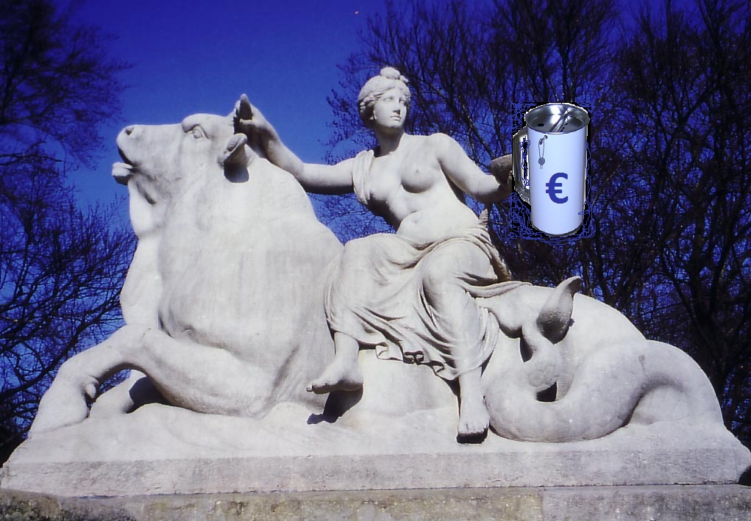
4.2.6. The European Debt Crisis 2010
Notes:
2
Europa (altgr. Εὐρώπη, Evrópe, altgriechische Aussprache Eurṓpē; Näheres zum Namen siehe unter Europa), eine Gestalt der griechischen Mythologie, ist die Tochter des phönizischen Königs Agenor und der Telephassa. Zeus verliebte sich in sie. Er verwandelte sich wegen seiner argwöhnischen Gattin Hera in einen Stier. Sein Bote Hermes trieb eine Kuhherde in die Nähe der am Strand von Sidon spielenden Europa, die der Zeus-Stier auf seinem Rücken entführte. Er schwamm mit ihr nach Matala auf der Insel Kreta, wo er sich zurückverwandelte. Der Verbindung mit dem Gott entsprangen drei Kinder: Minos, Rhadamanthys und Sarpedon. Auf Grund einer Verheißung der Aphrodite wurde der fremde Erdteil nach Europa benannt.

Slide 124
4.2.6. The European Debt Crisis 2010
The crisis can be seen as the result of two factors:
  One interest rate only for 17 member states!
  As seen in chapter 6.2.3., business banks of all member states can borrow money from the ECB at the same interest rate.
  A differentiation of the interest rate according to the different home countries of the commercial banks is not practiced.
  As a consequence, the interest rate for bank credits (especially mortgage and firm credits) have aligned in all member states („interest-rate-pass-through“).
Notes:
2

Slide 125
4.2.6. The European Debt Crisis 2010
Different inflation rates in all 17 member states!
Notes:
2

Slide 126
4.2.6. The European Debt Crisis 2010
Different inflation rates in all 17 member states!
Notes:
2

Slide 127
4.2.6. The European Debt Crisis 2010
If nominal interest rates are identical, but inflation rates diverge, real interest rate diverge too:
  => Countries with high inflation rates experience low real interest rates!
  Countries with low inflation rates experience high real interest rates!
Notes:
2

Slide 128
4.2.6. The European Debt Crisis 2010
Convergence of nominal interest rates & divergence of real interest rates using the example of 10 years govern. bonds :
Notes:
2
Keeping in mind this formula, it is easy to understand this diagram: The blue line shows the development of the variance of the nominal interest rates. It had nearly disappeared with the beginning of the European Currency Union in January 1999. This what means that there has been conversion of nominal interest rates.
At the same point in time the variance of inflation rates had become smaller, but did never completely disappear.
As a consequence, the variance of real interest rates became larger with the beginning of the European Currency Union – just as the real interest rate formula implies!

Slide 129
4.2.6. The European Debt Crisis 2010
Divergence of real interest rates using the example of 10 years government bonds :
Notes:
2
As this diagram shows: Given its low inflation rates Germany experienced most of the time much higher real interest rates as the crisis countries!

Slide 130
4.2.6. The European Debt Crisis 2010
Equilibrium interest rate, if all countries would experience the same inflation rate.
What consequences have different real interest rates for the capital market:
r = real interest rates
r = real interest rates
S(Y)
S(Y)
Excess supply of credits
r_{L}*
r*
r_{H}*
I(Y)
Excess demand for credits
I(Y)
S, I
S, I
Low Inflation Country: r_{L}* = i*- π_{L}
High Inflation Country: r_{H}* = i*- π_{H}
Notes:
2
This figure shows, what consequences diverging real interest rates have for the capital market:
…
The low inflation country builds up a net creditor position.
The high inflation country builds up a net debtor position.

Slide 131
The ECU total capital market is in equilibrium, while there is a disequilibrium on the capital market of the member countries!
The average interest rate is equal to the market equilibrium rate: (r_{L}* + r_{H}*) /2 = r*
r = real interest rates
r = real interest rates
S(Y)
S(Y)
Excess Supply of credits
r_{L}*
r*
r_{H}*
I(Y)
Excess demand for credits
I(Y)
S, I
S, I
Low Inflation Country: r_{L}* = i*- π_{L}
High Inflation Country: r_{H}* = i*- π_{H}
- 131 -
Notes:
131
2
The total capital market of the European Currency Union is in equilibrium,
while there is a disequilibrium on the capital markets of the member countries!

Slide 132
4.2.6. The European Debt Crisis 2010
Result of diverging interest rates:
  The high inflation country has an incentive to borrow from the low inflation country, because of its low real interest rate.
  The low inflation country has an incentive to lend money to the low inflation country, because of its the high real interest rate.
If this scenario holds on over several years, the high inflation country will accumulate more and more debt hold by the low inflation country:
  The following diagram shows that this mechanism has been at work in the ECU over a long span of time:
Notes:
2
Result of diverging interest rates:
The high inflation country has an incentive to borrow from the low inflation country, because of its low real interest rate.
The low inflation country has an incentive to lend money to the low inflation country, because of its the high real interest rate.

Slide 133
4.2.6. The European Debt Crisis 2010
The lower the real interest rate, the higher the accumulated net debt position.
Notes:
2

Slide 134
4.2.6. The European Debt Crisis 2010
The higher the inflation rate (the lower the real interest rate), the higher the accumulated net debt position.
Notes:
2

Slide 135
4.2.6. The European Debt Crisis 2010
The rise of the net debt position of the high inflation countries went hand in hand with the rise of a net savings position of the low inflation counties.
Notes:
2

Slide 136
4.2.6. The European Debt Crisis 2010
Why did this process continue over a period of nearly 10 years?
  The above process can give rise to a self-enforcing debt spiral (positive feed-back loop) :
    Credits flow from the low inflation country to the high inflation country.
    In the high inflation country, these credits are used to buy goods. The demand for goods grows therefore over the supply of goods in the high inflation country.
    If the goods demanded in the high inflation country are not tradable (e.g. real estate or services), an excess demand for goods produced in the high inflation country results.
    This excess demand causes then again inflation!
Notes:
2

Slide 137
4.2.6. The European Debt Crisis 2010
    In the low inflation country, the credit flow to the high inflation country causes a loss of purchasing power.
    If this loss of purchasing power is not compensated by an export demand from the high inflation country, excess supply results in the low inflation country.
    This excess supply causes then again a lower inflation rate in the low inflation country.
  Consequently, if the goods demanded for by the high inflation country are not perfectly tradable, the inflationary differences will prevail!
  The following circular flow presentation displays this relationship graphically:
Notes:
2

Slide 138
4.2.6. The European Debt Crisis 2010
Self-enforcing debt-spiral:
High (low) real interest rate in HIC (LIC).
Indebtedness (Net savings) in HIC (LIC).
High (low) inflation in HIC (LIC).
Reduction of demand for goods in LIC.
Demand for non-tradable goods in HIC grows.
Notes:
2

Slide 139
4.2.6. The European Debt Crisis 2010
When will the debt spiral come to a standstill?
  The growing indebtedness of the high inflation country causes a higher credit default probability.
  As soon as capital markets become aware of this, risk premiums in the interest rates start to grow an cause higher real interest rates for the high inflation country.
  This sets an incentive for the high inflation country to reduce its demand for debt.
  As the historical experience shows, it needs some time before capital markets become aware of this.
Notes:
2

Slide 140
4.2.6. The European Debt Crisis 2010
Consequently, the European debt crisis is not a sovereign debt crisis, but a debt crisis of the private sector of the high inflation countries.
The following diagrams display this:
Notes:
2

Slide 141
4.2.6. The European Debt Crisis 2010
Notes:
2

Slide 142
4.2.6. The European Debt Crisis 2010
Notes:
2

Slide 143
4.2.6. The European Debt Crisis 2010
Notes:
2

Slide 144
4.2.6. The European Debt Crisis 2010
Notes:
2

Slide 145
4.2.6. The European Debt Crisis 2010
In the short run: What measures are necessary to overcome the crisis?
  The Governments of indebted countries have overtaken the bad debt losses of the commercial banks in their countries. This has caused an increase of the government indebtedness.
    Debt restructuring (=„haircut“=partial bankruptcy) => Problem: Loss of receivables of creditor banks endangers stability of the financial sector („Lehman Brothers”-effect, “Banking Domino”)
    Budget reorganization with „ESM-credits“ => Will countries like Greece, Portugal, Spain and Ireland be able to sustain the consequences of austerity policies: violent protest rallies? general strikes? Political stability strong enough?
    Up to know budget reorganization based on austerity policies has not been very successful:
Notes:
2

Slide 146
4.2.6. The European Debt Crisis 2010
Notes:
2

Slide 147
4.2.6. The European Debt Crisis 2010
Notes:
2

Slide 148
4.2.6. The European Debt Crisis 2010
Notes:
2

Slide 149
4.2.6. The European Debt Crisis 2010
Notes:
2

Slide 150
4.2.6. The European Debt Crisis 2010
Notes:
2

Slide 151
4.2.6. The European Debt Crisis 2010
Current situation:
  As a result total government debt levels have become even larger and unemployment rates have reached levels that can threaten political stability:
Notes:
2
(http://www.ecb.int/press/key/date/2012/html/sp120726.en.html)

Slide 152
4.2.6. The European Debt Crisis 2010
Notes:
2

Slide 153
4.2.6. The European Debt Crisis 2010
Notes:
2

Slide 154
4.2.6. The European Debt Crisis 2010
Notes:
2

Slide 155
4.2.6. The European Debt Crisis 2010
Notes:
2

Slide 156
4.2.6. The European Debt Crisis 2010
Notes:
2

Slide 157
4.2.6. The European Debt Crisis 2010
Current situation:
  3 Years have passed by now, since the beginning of the crisis
  Neither the ESM (European Stability Mechanism =„European Rescue Fund“) nor the „Fiscal Compact“ had been able to calm the markets.
  Risk premiums for government bonds crisis country kept on growing until summer 2012 (see next diagram).
  Then, the president of the European Central Bank, Mario Draghi, was able to trigger a turnaround of markets when he declared “Within our mandate, the ECB is ready to do whatever it takes to preserve the euro. And believe me, it will be enough (…)”
Notes:
2
(http://www.ecb.int/press/key/date/2012/html/sp120726.en.html)

Slide 158
4.2.6. The European Debt Crisis 2010
Notes:
2

Slide 159
4.2.6. The European Debt Crisis 2010
Current situation:
  Currently, financial markets expect a turn of monetary policy in the USA.
  As a result, market interest rates for bonds are growing and with them risk premiums (see diagram).
  As it seems, the situation could soon get critical again for the European crisis countries.
Notes:
2
(http://www.ecb.int/press/key/date/2012/html/sp120726.en.html)

Slide 160
4.2.6. The European Debt Crisis 2010
Different inflation rates in all 17 member states!
Notes:
2

Slide 161
4.2.6. Questions for Review
You should be able to answer the following questions at the end of this chapter. All of the questions can be answered with the help of the lecture notes. If you have difficulties in answering a question, discuss this question with me at the end of the lecture, attend my colloquium or send me an E-Mail.

Slide 162
4.2.6. Questions for Review
Explain the four typical components of a financial market crisis.
Which behavior of investors can lead to a positive feedback loop on markets?
Explain the historical development of the Dutch Tulip Crisis based on the theory of speculative bubbles.
Explain the historical development of the World Economic Crisis on the basis of the theory of speculative bubbles.
Explain the historical development of the Dotcom Crisis based on the theory of speculative bubbles.
Explain the development course of the East Asian Financial Market Crisis on the basis of the theory of speculative bubbles.
Explain the historical development of the European debt crisis.

